Slide 1
Intro
To
Python
Code Afrique Team

Slide 2
What is Python?
A language to tell a computer what to do
Computers are stupid---they need to be told EXACTLY what to do
There are many programming languages
Python is good for learning to program

Slide 3

Basic concept: Functions
For example:
$f\left(x\right)= 3x + 4$
$g\left(x\right)=$ $\sqrt{x}$
$sum\left(x, y\right)= x + y$

Slide 4
Functions in Python
def f(x):
return 3 * x + 4
def square(x):
return x * x
Function header
Body
Notes:
In Python, function is a group of related statements that perform a specific task.Let them play around on the laptops with creating their own functions. Do not forget to mention DOC strings

Slide 5
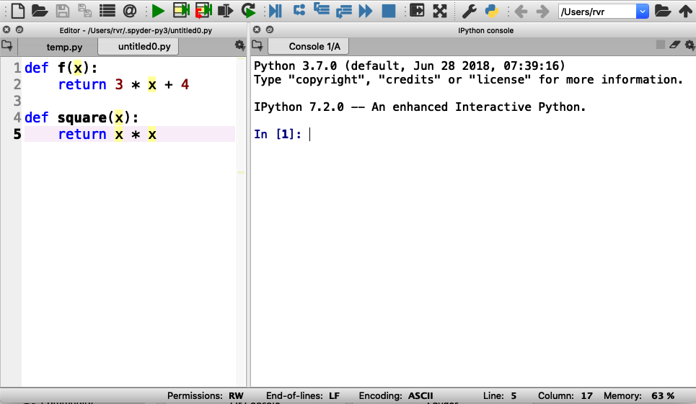
Using Spyder
Step 1: Enter functions in this box
Notes:
Everybody should do this. Wait for everybody to be done

Slide 6
Using Spyder
Step 2: Click on the green triangle (don’t forget)

Slide 7
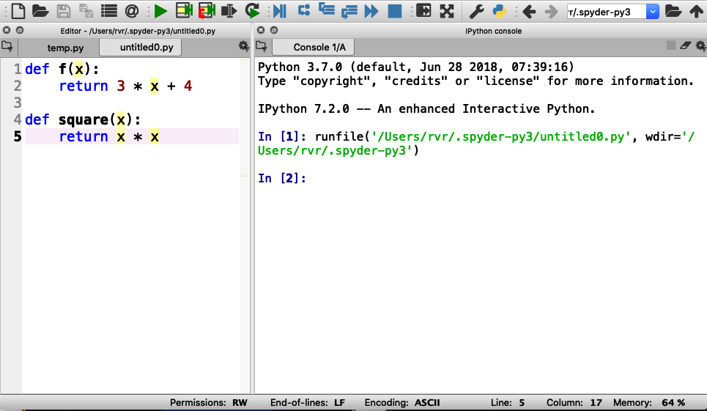
Using Spyder
Step 2: Click on the green triangle (don’t forget)
Output (and error messages) appear in “console” box

Slide 8

Using Spyder
Step 3: Type a function call here and hit “enter”

Slide 9
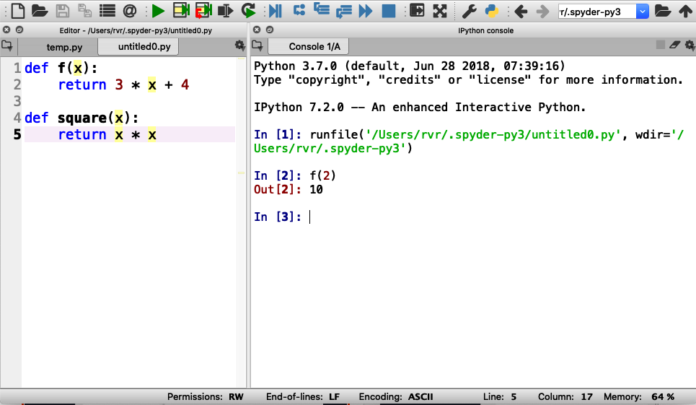
Using Spyder
Step 3: Type a function call here and hit “enter”
Result of function printed here
Notes:
After this, have them try other invocations of f() and square()

Slide 10

Try the following (and take turns!):
$f(0)$
$f(0.5)$
$f(−3)$
$square(−3)$
$square(123456789)$
$square(f(0))$

Slide 11

Time for you to play
Write the following function in Python :
$g\left(x\right)=x^{2}$ $+ 2x + 3$
Evaluate the following:
$g(0)$
$g(1)$
$g(−0.5)$
Notes:
Add

Slide 12

More time for you to play
Write a function $add\left(x, y,z\right)$ that returns the sum of its three inputs (that is, $x + y + z$)
Evaluate the following:
$add(1, 2, 3)$
$add(1, 1, −2)$
Notes:
Add

Slide 13
Errors and Bugs….
Remember: computers are stupid
Everything needs to be EXACTLY right

Slide 14
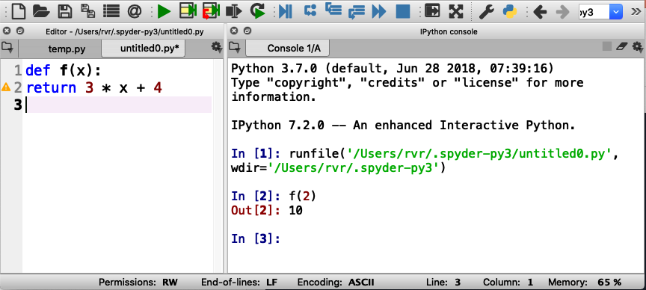
Indentation error
Everything in a function
MUST BE indented

Slide 15
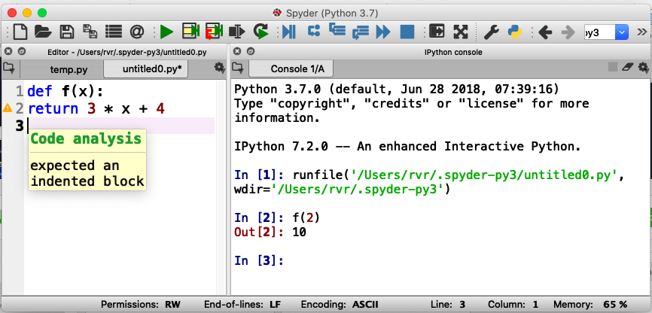
Indentation error
Hover mouse over triangle for information about the error

Slide 16
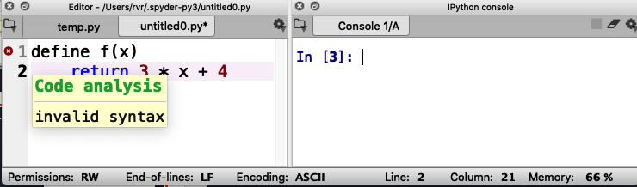
Syntax error
Missing :

Slide 17
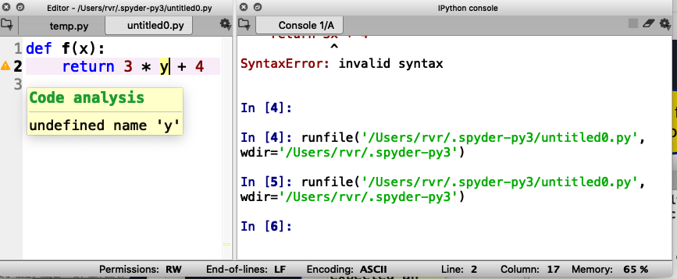
Undefined name warning
Should be ‘x’, not ‘y’

Slide 18
Remember: Keep hitting that green triangle
You need to do that each time you change or fix your code!

Slide 19
“Strings”

Slide 20
Strings!!
Examples of strings: “hello” “I love Code Afrique” “fdalepru”
A string is enclosed in quotation marks (“)
You can glue together two strings using +
For example, “hello, “ + “Jon” == “hello, Jon”

Slide 21
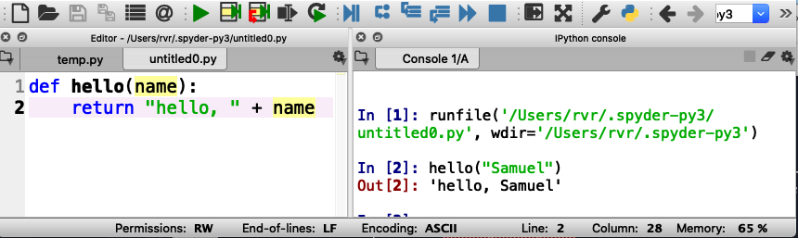
Functions with strings
Write a function hello(name) that returns the string “hello, name”

Slide 22
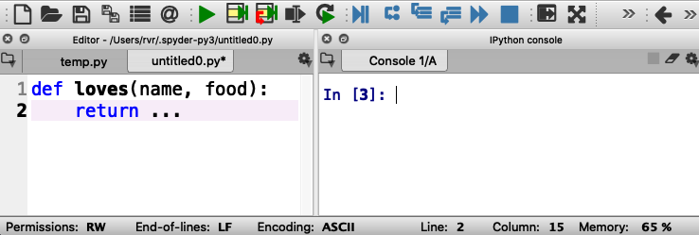
Now you try it
Write a function loves(name, food) that returns a string “name loves food”
Be sure to test it here
(and take turns!)
dot dot dot
Write your function here

Slide 23
What is your Code Afrique nickname?
Write a function nickname(first, last) that consists of the first three letters of your name (first name) followed by the last three letters of your surname (last name) , followed by “ca” (for Code Afrique)
For example: nickname(“Hakim”, “Weatherspoon”) == “Hakoonca”
You’ll need to learn about ”indexing” first

Slide 24
String indexing
A position in a string is called an index
Indexes start counting at 0
Shoshana
01234567
The index of ‘o’ is 2

Slide 25
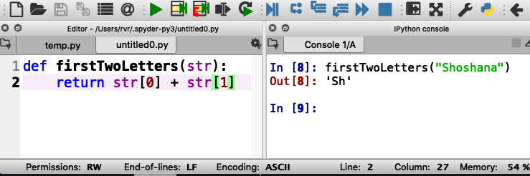
String indexing
Write a function firstTwoLetters(str)that returns the first two letters in the input string str
str[x] evaluates to the letter at index x

Slide 26
Quiz
If a string has 10 letters, what is the index of the last letter?
9
10
11
Notes:
The correct answer is 9

Slide 27
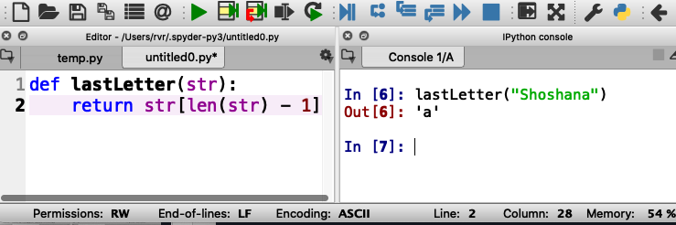
Length of a string
Write a function lastLetter(str)that returns the last letter in the input string str
Uses len(str) that returns the length of str

Slide 28
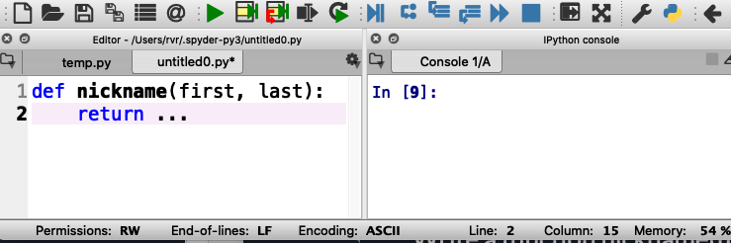
What is your Code Afrique nickname?
Write a function nickname(first, last) that consists of the first three letters of your name (first name) followed by the last three letters of your surname (last name) , followed by “ca” (for Code Afrique)
For example: nickname(“Hakim”, “Weatherspoon”) == “Hakoonca”

Slide 29
Lists

Slide 30
Examples of lists
[ 1, 2, 3 ] : a list of integers
[ 3.1415, 2.82 ]: a list of floating point numbers
[ “cats”, “dogs”, “elephants” ]: a list of strings
[ ]: an empty list
Fun fact: a string is a list of letters, and everything you can do with strings you can also do with other lists

Slide 31
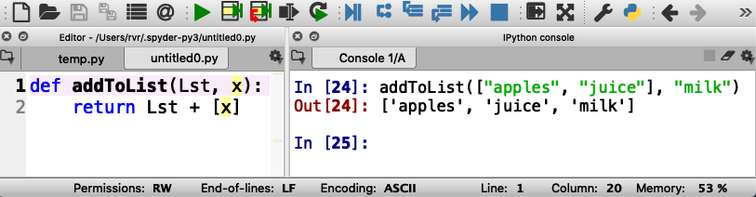
Example function with lists
Write a function addToList(Lst, x) that returns a new list consisting of Lst and x
For example addToList([ “apples”, “juice” ], “milk”) == [ “apples”, “juice”, “milk” ]
List consisting of x
Notes:
Have students type this in and try out other examples

Slide 32
Try it out (and take turns!)
Notes:
Have students type this in and try out other examples

Slide 33
Variables

Slide 34
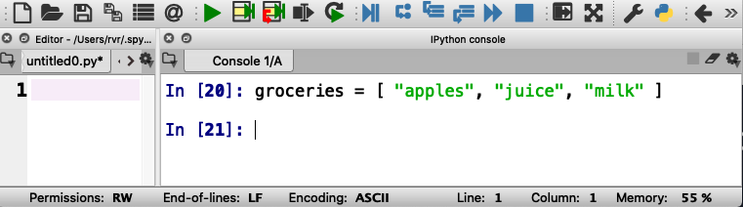
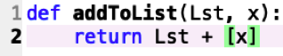
How to keep a shopping list?
groceries is a “variable”

Slide 35
How to keep a shopping list?
groceries is a “variable”
= in Python is used to assign a value to a variable
(do not confuse with ==)

Slide 36
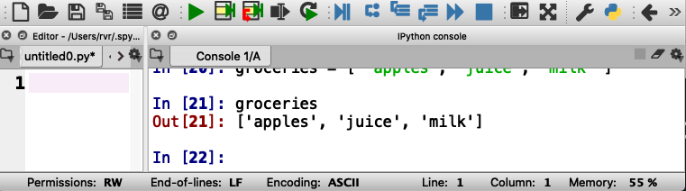
How to keep a shopping list?
Python remembers the values of variables, which can be lists, numbers, strings, and more.
Here the value of groceries is a list of strings.

Slide 37
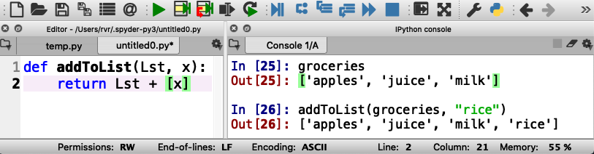
Adding “rice” to the shopping list
Does it work?

Slide 38
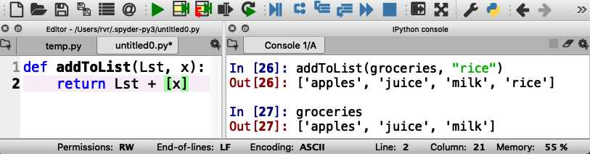
Adding “rice” to the shopping list
The value of groceries has not changed…

Slide 39
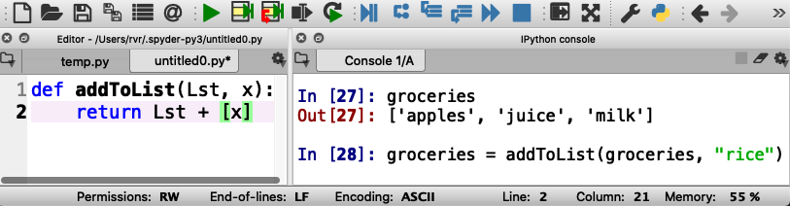
Adding “rice” to the shopping list
Here we update groceries with a new value

Slide 40
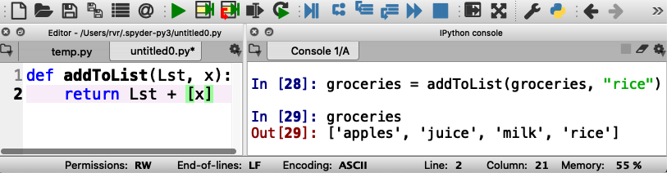
Adding “rice” to the shopping list
Now “rice” is in the list

Slide 41
Adding “rice” to the shopping list
Now practice adding some more items to groceries

Slide 42
Loops

Slide 43
Doing something with each element of a list
Write a function product(Lst) that returns the product of all elements in a list of numbers
How would you do this writing on a piece of paper?

Slide 44
Doing something with each element of a list
Write a function product(Lst) that returns the product of all elements in a list of numbers
How would you do this writing on a piece of paper?
Start with the first number
Multiply with the next number
Repeat until done with all numbers
This is called a “loop”

Slide 45
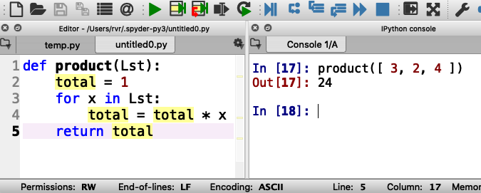
Loops in Python

Slide 46
Loops in Python
total is a variable

Slide 47
Loops in Python
total is a variable
x is the next element in Lst

Slide 48
Loops in Python
total is a variable
x is the next element in Lst
total is updated each time

Slide 49
Loops in Python
total is a variable
x is the next element in Lst
total is updated each time
Here, total == 1 * 3 * 2 * 4

Slide 50
Write your own: below change product to sum That is, add all the items in the list together

Slide 51
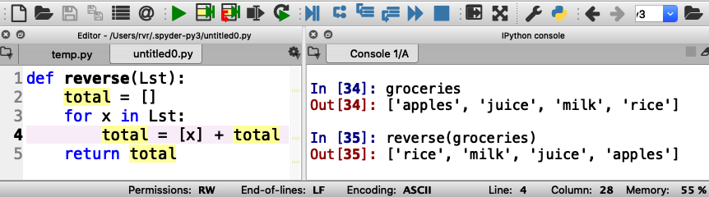
Example: write a function reverse(Lst) that reverses the elements in a list

Slide 52
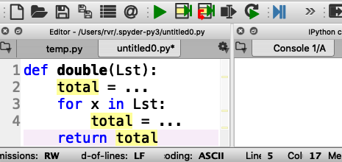
Your turn to practice (remember: everybody gets a turn!)
Write a function double(Lst) that returns a list consisting of all the numbers in Lst, but then doubled
For example, double([ 3, 1, 4 ]) should return [ 6, 2, 8 ]

Slide 53
Working with ranges
Write a function squares(start, end) that returns a list of all the squares of the numbers start (inclusive) through end (exclusive)
(in Computer Science, “inclusive” means that the value is included, and “exclusive” means that the value is excluded)
For example, squares(1, 10) returns
[ 1, 4, 9, 16, 25, 36, 49, 64, 81 ]

Slide 54
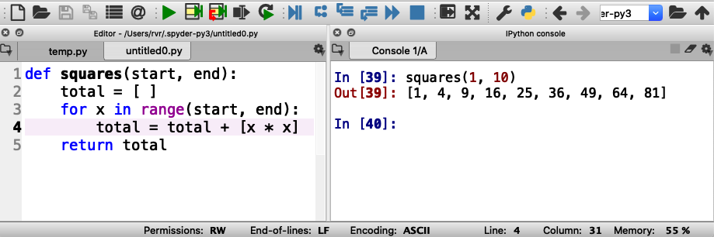
Working with ranges
range(start, end) generates the integers from start (inclusive) to end (exclusive)

Slide 55
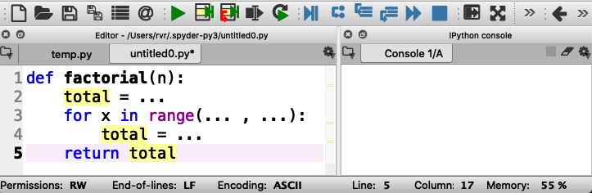
Now you practice with ranges
Write function factorial(n) that returns n!
n! is defined to be the product of all the integers from 1 to n
For example, factorial(3) is equal to 1 * 2 * 3 (that is, 6)

Slide 56

IF STATEMENTS

Slide 57
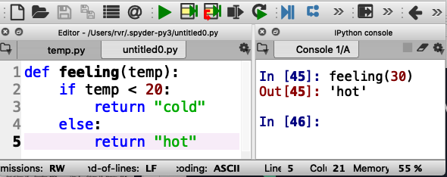
What if you want to do something only sometimes?
Write function feeling(temp) that returns “cold” if temp < 20 or “hot” otherwise

Slide 58
Correct indentation is important!

Slide 59
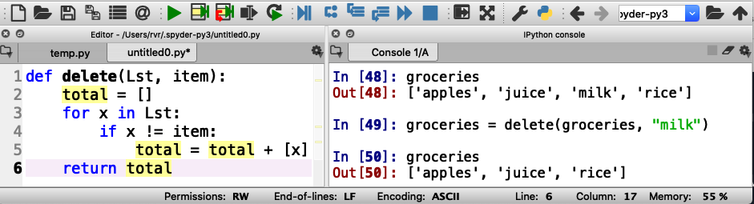
Using if statements in for loops
Write a function delete(Lst, item) that returns a list consisting of the elements of Lst except for item
!= means “is not the same as”

Slide 60
Correct indentation

Slide 61
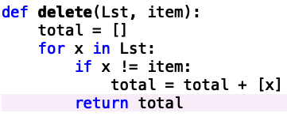
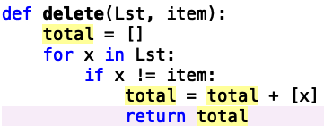
Incorrect indentations: what do these do?

Slide 62
Incorrect indentations: what do these do?
This returns after the first element in Lst
This returns after the first element that is not item
Notes:
Also, doesn’t return anything if the list is empty

Slide 63
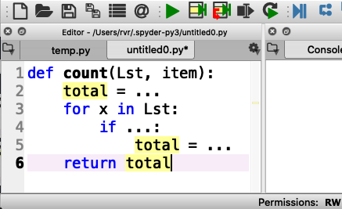
Your turn to practice
Write a function count(Lst, item) that counts how many times item occurs in Lst
For example, count([“apples”, “juice”, “milk”], “juice”) should return 1

Slide 64
Programs with multiple functions

Slide 65
How to write difficult programs
Split program into multiple definitions
Write a function shop(Lst, item) that returns the string “we have item” if item is in Lst, or “we need item” if not
For example: shop(groceries, “rice”) returns
“we have rice” if ”rice” is in groceries

Slide 66
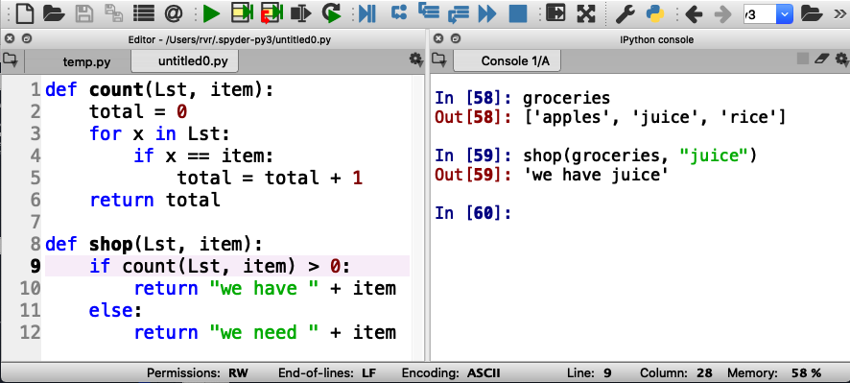
How to write difficult programs
Split program into multiple definitions
Write a function shop(Lst, item) that returns the string “we have item” if item is in Lst, or “we need item” if not

Slide 67
Just a little math before we go on

Slide 68
Two types of numbers
“integers”
Examples: 0, 1, 2, 3, -3, 93723881
”floating point numbers”
Examples: 3.14159, -0.05, 123.45

Slide 69
Division with integers and floating point numbers
What is 9 divided by 4?
Using integers, it is 2 with a remainder of 1
Using floating point numbers, it is 2.25

Slide 70
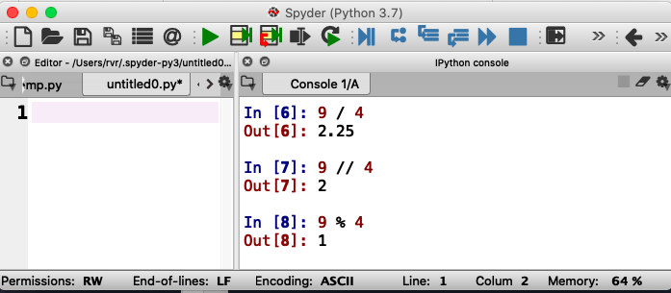
Same thing in Python
Floating point division
Integer division
Integer remainder (modulo)
You say “9 modulo 4”

Slide 71
Approaching Coding Questions

Slide 72
A 3-Step Approach To Coding Problems
Read the question carefully. Understand what information you have available to you and what the question wants you to do.
Try to write out an algorithm or solution to the problem in “English” or “pseudocode”.
Translate your English solution to code

Slide 73
Example
Q: Write a function isEven(x) that returns “even” if x is even and “odd” if not

Slide 74
Step 1: Read the question carefully
Q: Write a function isEven(x) that returns “even” if x is even and “odd” if not
After reading the question, we see that we have one integer number as our only input.
Since our function only has one input, our function header will look something like:
def isEven(x):

Slide 75
Step 2: Design a solution in “English”
Q: Write a function isEven(x) that returns “even” if x is even and “odd” if not
If the input parameter is divisible by 2, then we know it is even
Otherwise, it must be odd
We also know that we can check if something is divisible with the modulo operator, %

Slide 76
Step 3: translate English into code
If the input parameter is divisible by 2, then it is even
if num % 2 == 0:
return “even”
Otherwise, it must be odd
else:
return “odd”

Slide 77
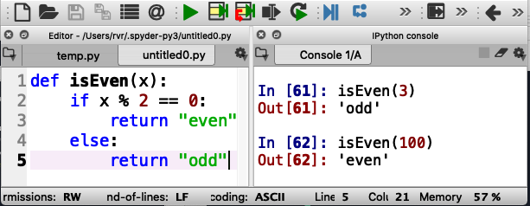
Finally, test it out
Test carefully!

Slide 78
A primer on conversion

Slide 79
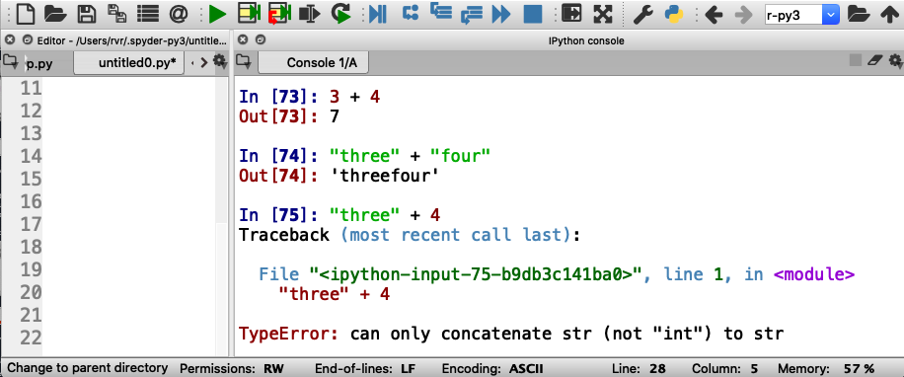
Strings and Numbers
3 + 4 == 7
“three” + “four” == “threefour”
What is ”three” + 4?

Slide 80
Strings and Numbers
3 + 4 == 7
“three” + “four” == “threefour”
What is ”three” + 4?

Slide 81
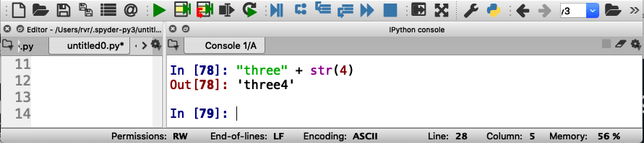
Converting integers to strings
str(123) == “123”

Slide 82
Input/Output

Slide 83
Python functions can “print” (output) and read from the keyboard or even files (input)
Write a function needToShop(Lst) that asks for the name of an item and prints the item and how many instances of the item are in Lst
Note: the item is not an input parameter to needToShop(Lst)

Slide 84
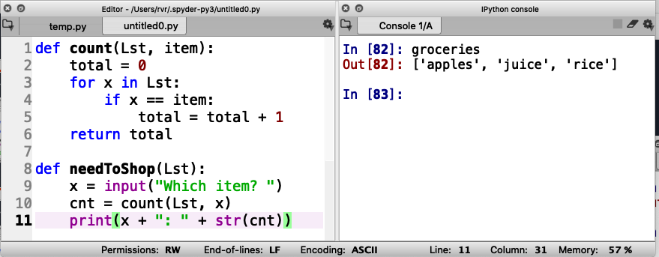
Function needToShop(Lst)

Slide 85
Function needToShop(Lst)
Read input

Slide 86
Function needToShop(Lst)
Read input
Write output

Slide 87
Function needToShop(Lst)
Read input
Write output
Note integer to string conversion

Slide 88
Function needToShop(Lst)
Read input
Write output
no return statement

Slide 89
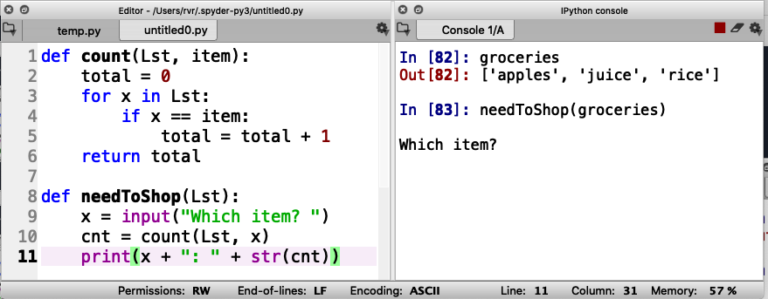
Function needToShop(Lst)
Call function here
Read input
Write output

Slide 90
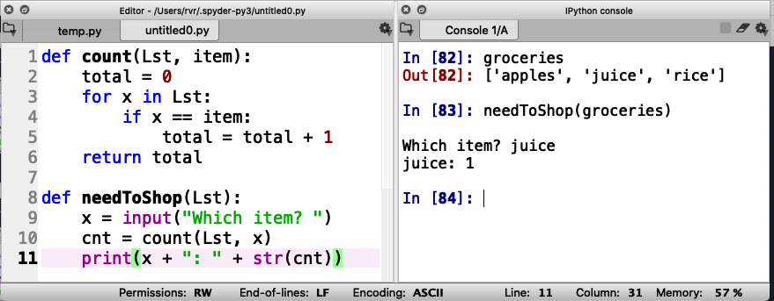
Function needToShop(Lst)
Call function here
Read input
Enter input here
Write output

Slide 91
Try it yourself (and make sure everybody gets a turn!)
Call function here
Read input
Enter input here
Write output

Slide 92
Give it a shot yourself (and take turns!)

Slide 93
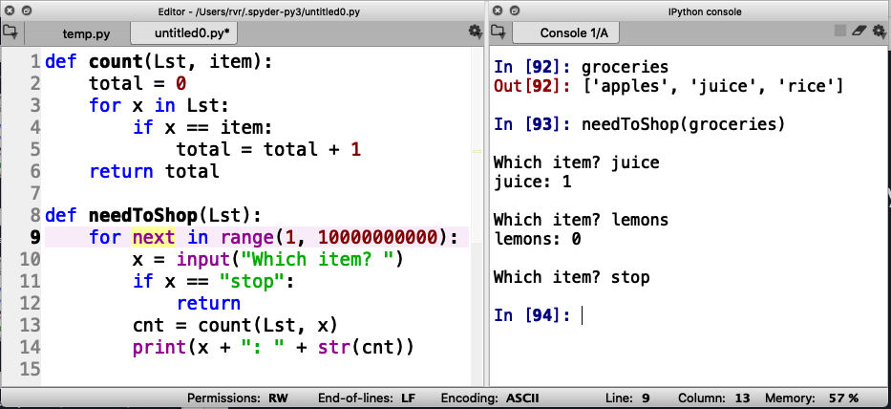
Input/Output in a loop
How to ask for input over and over again?

Slide 94
Input/Output in a loop
How to ask for input over and over again?
Long loop

Slide 95
Input/Output in a loop
How to ask for input over and over again?
Long loop
Add a way to stop

Slide 96
Input/Output in a loop
How to ask for input over and over again?
Long loop
Add a way to stop
Return with no value

Slide 97
Try it out

Slide 98
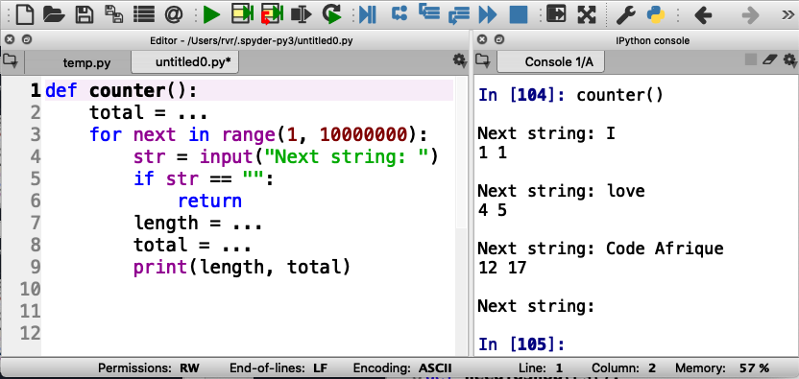
Trying it out some more
Write a function that, in a loop, reads a string and prints the length of the string and the total length of all the strings that were input. Stop if the input is the empty string (“”).
Recall that len(str) returns the length of string str

